Slide 1
A Feature-Based of IT Automation using Kaseya
Developed By: Gregory Hayes
Advisor : Dr. S. Masoud Sadjadi School of Computing and Information Sciences Florida International University
ghaye001@fiu.edu
http://www.cs.fiu.edu/~sadjadi/

Slide 2
Agenda
Problem and Motivation
Solution
Behind the Scene
Customizing the Solution
Disclaimer
Progress Report

Slide 3
Problem and Motivation:
My problem is employees at my job are continuing to clutter up their workstations with music. Bring their music collections to work either on usb drives, downloading, or other means and copying their music onto their work computers. This takes up a good deal of space on the local hard drives that is limited as it is.

Slide 4
Solution
The solution I’ve decided to use is to use kaseya. The tool I’ve picked to use to help me with my problem is to make an agent procedure to collect data on the number of mp3 files residing on the local computer (C:\), so that they can be delete.

Slide 5
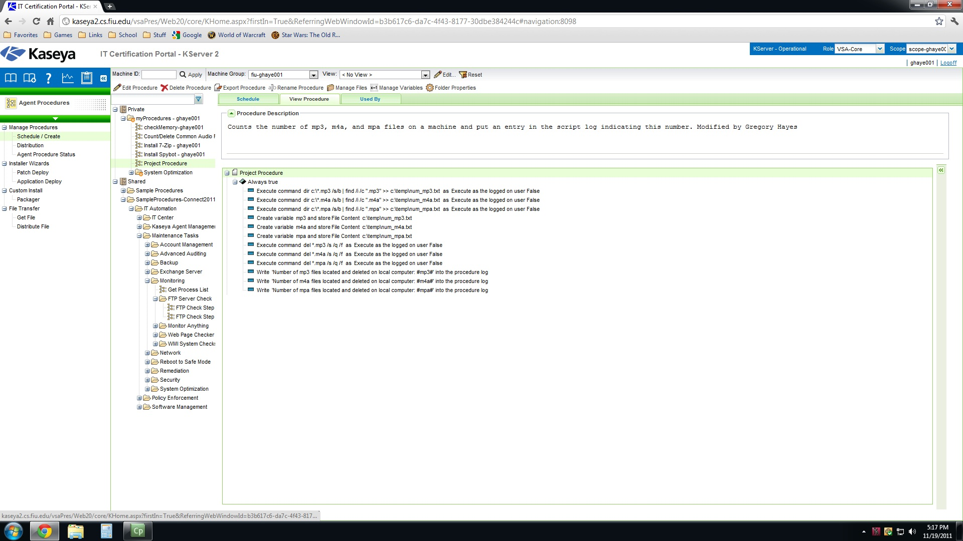
Fig 2.1

Slide 6
Behind the Scene
In Part1 I created a procedure to count the number of mp3 files on the local computer and pipe the information into a text file to use. Then I create a variable to store the number of files on the computer that was saved to the text file. Then I execute a deletion of these files found on the local computer. Then write the number of files found and removed into an agent procedure log.
In Part2 I created a schedule to run the new agent procedure once a day at 5pm and applied it to instructional template.

Slide 7
Behind the Scene
In Part3 I copied the new agent procedure schedule saved to the instructional template to the needed computers in SCIS and CEC.
In Part4 I ran a report to see how many files the agent procedure detected and deleted from the local computer.

Slide 8
Customizing the Solution
The procedure would be effective on windows XP, 2000 and 7 however if want to use it on Mac I would need to make a few changed to the agent procedure.
The executed shell commands would need to be changed to work on Mac OS X. To find the correct file types you would need to use find instead of dir. You would also need to use rm to delete the file types instead of del.

Slide 9
Disclaimer
I tested the agent procedure on the Windows XP and server platforms. I didn’t test the procedure on all types of windows installations, but the procedure used windows commands and should work on all windows platforms.
The agent procedure wouldn’t work on a Mac OS X platform with out changed the commands used to Linux-based commands.

Slide 10
Progress Report
How far have you gone with your solution? - I’ve finished my solution.
What is still not done? – Final details then turn everything in.

